Slide 1
Counting 1
Including: Counting in our 2s, 5s, 10s and 3s, number bonds to 10, 20 and 100 and number facts.

Slide 2
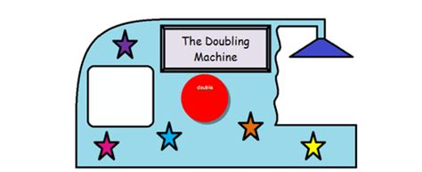
Warm up: The doubling machine
This is my doubling machine.

Slide 3
Warm up: The doubling machine
Whatever number goes in, comes out doubled.

Slide 4
Warm up: The doubling machine
I’m going to put in these numbers: 10, 14, 24, 50
What will
What numbers will come out?

Slide 5
Warm up: The doubling machine
I put in these numbers: 10, 14, 24, 50
Here is what came out.
This is what came out: 20, 28, 48, 100

Slide 6
Clap clap, clap clap clap clap
I will clap a set of times tables. When I say “now” you must clap the next number in the sequence!

Slide 7
The counting stick
Let’s count using the counting stick...
We will start with our 2s.

Slide 8
The counting stick
Let’s move on to our 5s.

Slide 9
The counting stick
Let’s move on to our 10s.

Slide 10
The counting stick
And finally, our 3s.

Slide 11
Number bonds
In year one and year two, you learned your number bonds to ten.
What is a number bond?

Slide 12
Number bonds
I will flash up a number. You must show your partner on your fingers how many more are needed to get to 10.
Ready? Let’s go!

Slide 13
Number bonds
7

Slide 14
Number bonds
3

Slide 15
Number bonds
5

Slide 16
Number bonds
6

Slide 17
Number bonds
2

Slide 18
Number bonds
4

Slide 19
Number bonds
8

Slide 20
Ping Pong
If I say ping, you say pong.
PING.
PING.
PING.

Slide 21
Ping Pong
Now, if I say a number, you quickly hit its partner number back to me so that together they make ten.
Beware – I will be getting faster and faster and faster.
Let’s go!

Slide 22
Ping Pong
Well done! You are excellent at this game... So let’s make it trickier.
Let’s play the same game, but this time you are hitting back the buddy number to 20!
Let’s go!

Slide 23
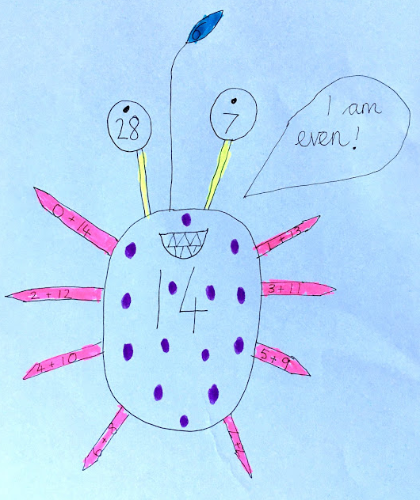
Number aliens
Great stuff! Your task now is to create number aliens following these instructions.
1 – its number (between 0 and 20) will be displayed in its body.
2 – it will have two eyes. One eye will show double its number and one will show half its number.
3 – It will have a pointy antennae which will show its number bond to make 20.
4 – It will have as many legs as there are additions to make its number.
5 – It will have a speech bubble saying whether it is odd or even.
Decorate your alien with coloured spots that match its number.

Slide 24
Number bonds... To 100!
Now, I will flash up a number. You must tell your partner how many more are needed to get to 100.
Ready? Let’s go!

Slide 25
Number bonds
70

Slide 26
Number bonds
90

Slide 27
Number bonds
30

Slide 28
Number bonds
50

Slide 29
Number bonds
60

Slide 30
Number bonds
20

Slide 31
Number bonds
40

Slide 32
Questions…
A (for awesome!)
Write down how many more are needed to get to 10.
4
7
6
1
3
9
8
5
2
B(for bravo!)
Write down how many more are needed to get to 100.
30
40
70
20
90
10
50
60
80
C(for clever clogs)
Write down how many more are needed to get to 100.
33
82
44
91
11
55
67
1
26

Slide 33
ANSWERS…
A (for awesome!)
Write down how many more are needed to get to 10.
6
3
4
9
7
1
2
5
8
B(for bravo!)
Write down how many more are needed to get to 100.
70
60
30
80
10
90
50
40
20
C(for clever clogs)
Write down how many more are needed to get to 100.
67
18
56
9
89
45
33
99
74

Slide 34
CHALLENGE!
Greater Depth Question 1
Always, Sometimes, Never
When you add 7 to a number ending in 8, your answer ends with 5. Explain your answer.
When you add 70 to a number ending in 8, your answer ends with 5. Explain your answer.
Greater Depth Question 2
From 4, 6 more is needed to get to 10.
How many more are needed to get to 1000 from 400?

Slide 35
CHALLENGE!
Greater Depth Question 2
From 4, 6 more is needed to get to 10.
How many more are needed to get to 1000 from 400?

