Slide 1
COUNTING 2
Value of digits within numbers, partitioning, ordering numbers

Slide 2
Warm up: Mathemagicians
In this activity, you will be doing battle, just like Harry Potter, but instead of spells you will be zapping each other with times tables.
You will hold your pencil up high in the air so the blunt end is sticking out (let’s be careful, we don’t really want anybody to get hurt!)
Your teacher will give you a times table and you will have 3 seconds of thinking time before you are allowed to zap your partner.
The quickest person with the correct answer wins.

Slide 3
Ping pong
If I say ping, you say pong.
PING.
PING.
PING.

Slide 4
Ping pong
Now, if I say a number, you quickly hit its partner number back to me so that together they make twenty.
Beware – I will be getting faster and faster and faster.
Let’s go!

Slide 5
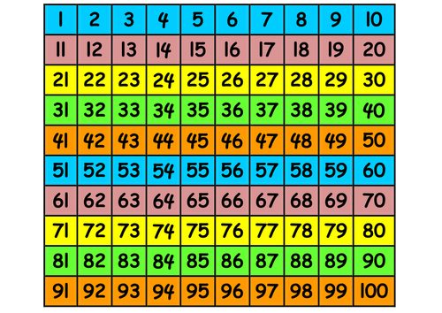
I’m thinking of a number
You will need a 100 square like this one.
I will give you a clue and you can narrow it down by crossing out the numbers it cannot be.
Okay… ready?

Slide 6
I’m thinking of a number
My number is odd.

Slide 7
I’m thinking of a number
My number is more than 10.

Slide 8
I’m thinking of a number
My number has one ten.

Slide 9
I’m thinking of a number
My number is in the three times tables.

Slide 10
I’m thinking of a number
Have you guessed it?

Slide 11
I’m thinking of a number
My number is 15!

Slide 12
Let’s look at a number
1 9 2

Slide 13
Let’s look at a number
H T O
1 9 2

Slide 14
Let’s look at a number
H T O
1 9 2
There are TWO ones.
There are NINE tens.
There is ONE hundred.

Slide 15
In your pairs
H T O
Draw a place value chart like mine.
Write down these numbers in the correct places on the chart:
111, 204, 344, 19, 931, 46

Slide 16
Ladders
Let’s play a game of ladders.
I will roll two 1-6 dice to generate two digits.
You can choose which order the digits go in.
You then place the digits in order on the ladder (biggest number near the top, smallest near the bottom). If you can’t go, you must write your number on the outside of your ladder.
Eg: if I rolled a 6 and a 1 I could have 61 or I could have 16. 61 would go near the top of my ladder and 16 near the bottom.
The first person to complete their ladder wins.

Slide 17
Let’s look at a number
H T O
6 4 3

Slide 18
Let’s look at a number
H T O
6 4 3
There are THREE ones.
There are FOUR tens.
There are SIX hundreds.

Slide 19
In your pairs
Put these numbers into order from smallest to largest.
101, 64, 240, 44, 204, 46, 1
Explain to your partner how you know where the numbers should go.

Slide 20
Questions…
A
Write down the value of the underlined digit.
44
57
644
20
99
112
137
224
B
Explain how many hundreds, tens and ones there are in these numbers.
381
576
161
200
79
119
524
803
C
Write these numbers on a place value chart.
380
570
160
200
790
306
901
706

Slide 21
Questions…
A
Put these numbers into order.
45, 54, 44, 55
7, 77, 707, 777
607, 601, 617, 610
24, 22, 44, 42
834, 821, 812, 843
200, 198, 201, 299
B
Make all the possible combinations of numbers from the following digits.
5, 6 and 7
1, 2 and 9
8, 4 and 0
C
I am thinking of a number.
My number is between 300 and 500.
The digits add up to 14. The difference between the largest and the smallest digit is 2.
What could my number be?
Order all the possible numbers from smallest to largest.

Slide 22
Greater depth
Greater Depth Question 1
Find the value of A in these questions.
A = 500 + 70 + 4
628 = A + 20 + 8
703 = 700 + A + 3

Slide 23
Greater depth
Greater Depth Question 2
What is the same about these numbers and what is different? 375 and 357

