Slide 1
The four operations

Slide 2
Warm up: Ladders!
Let’s have a game of ladders.
I will roll a dice to generate two different numbers. You must choose which order to put the digits in. (If I roll a 6 and a 2 you could have 62 or 26).
You must then place them on your ladder (make sure there are six rungs) with the smallest number at the bottom and the largest at the top.

Slide 3
PING PONG
When I say ping, you say pong…
PING
PING
PING

Slide 4
PING PONG
Today we will do the ten times tables. If I say a number, you must divide it by two.

Slide 5
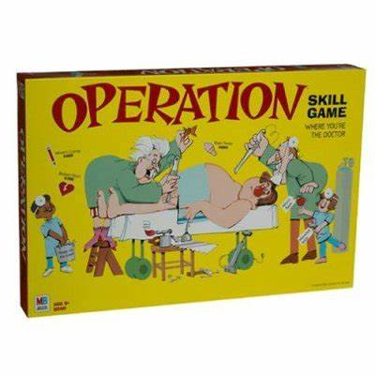
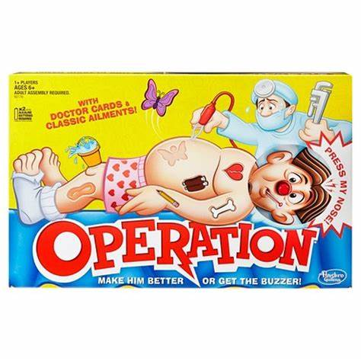
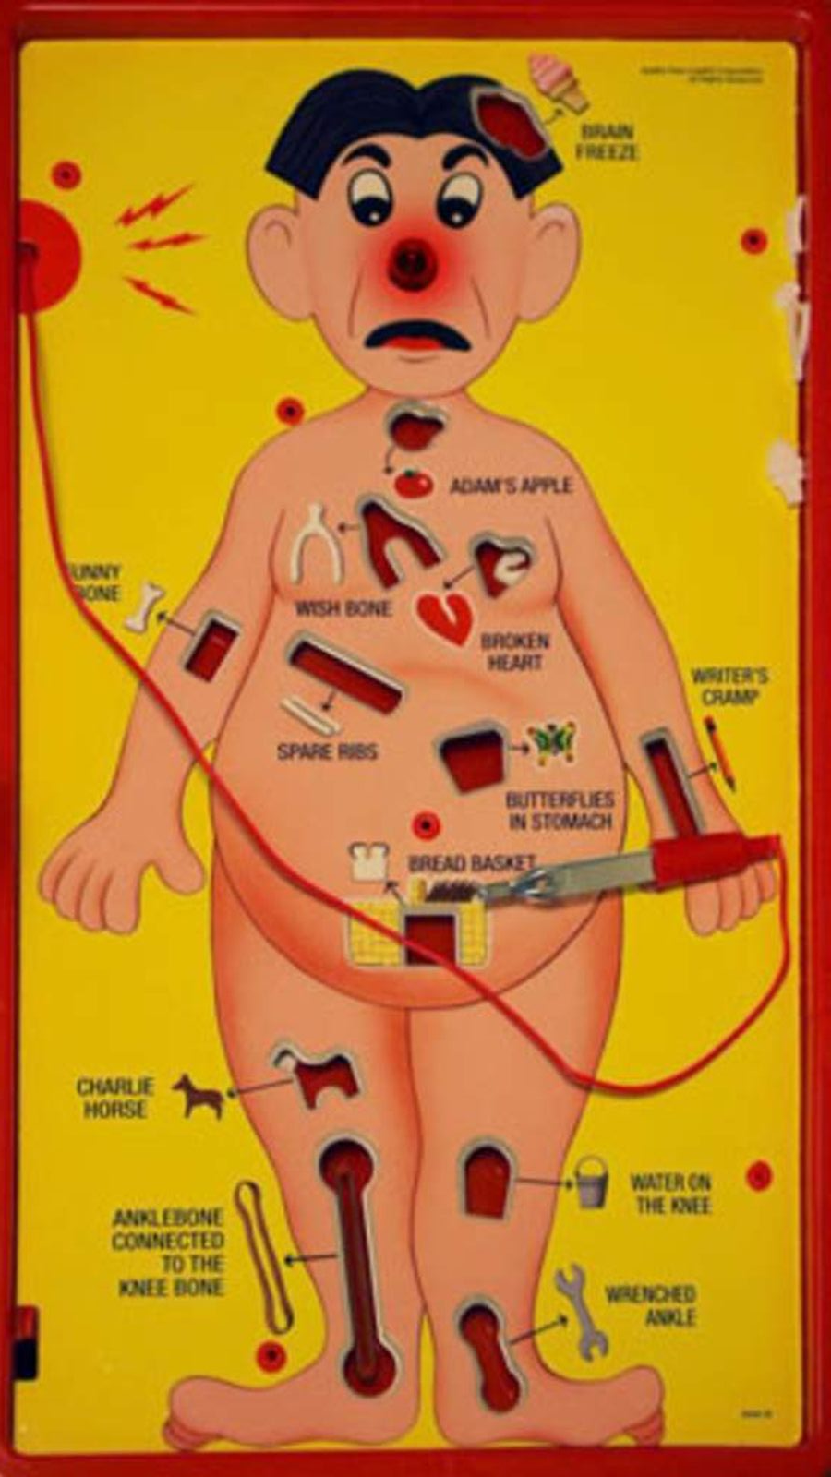
What do we mean by the four operations?
Clue – it’s nothing to do with board games!

Slide 6
What do we mean by the four operations?
The four operations are our mathematical tools for making numbers bigger or smaller.
Two of them make numbers bigger*. Can you name them?
Two of them make numbers smaller*. Can you name them?
* Actually, when you get to year 5 and 6 you’ll find this isn’t always true, but for now let’s say it is.

Slide 7
What do we mean by the four operations?
The two operations that make numbers bigger are:
Add and multiply
+ X
The two operations that make numbers smaller are:
Subtract and divide
- ÷ or sometimes /

Slide 8
Let’s have a go at some adding
Top tip: When you have an addition to do, you always begin with the ones column*.
Have a go at adding these numbers.
21 + 7
35 + 43
49 + 52
113 + 44
248 + 399
* Unless your number includes decimals… but that’s for later in the year.

Slide 9
Let’s have a go at some Takeaways
I love takeaways.
Especially pizza.

Slide 10
Let’s have a go at some subtractions
Top tip: Remember to always start with the bigger number when subtracting.
35 – 15
89 – 14
118 – 18 =
293 – 88 =
354 – 99 =

Slide 11
Let’s have a go at some division
This is an area that really divides people…
10 ÷ 2 =
50 ÷ 5 =
120 ÷ 3 =
275 ÷ 5 =
309 ÷ 4 =

Slide 12
Let’s have a go at some multiplications
9 x 5 =
15 x 3 =
27 x 10 =
98 x 4 =
112 x 3 =

