Slide 1
Morning activities
Key Stage 1 – Pack one

Slide 2
Draw an alien
On your whiteboard, draw an alien. It must have:
One body.
Two heads.
Three arms.
Four mouths.
Five bits of curly hair.
Six eyes.
Seven spots.
Eight teeth.
Nine bits of zig zag hair.
Ten legs.

Slide 3
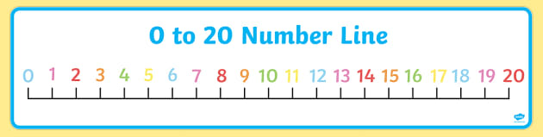
Number lines
Use a number lines to answer these addition questions.
4 + 2 =
6 + 2 =
5 + 4 =
12 + 5 =
10 + 7 =
8 + 5 =

Slide 4
Phonics alien words
Some of these phase 3 words are real words and some are alien words. Draw a line down your whiteboard and put the real words on one side and the alien words on the other.
fur
burn
glur
durnip
charky
snarl
charm
star
curl
sharg
spurger
blurk

Slide 5
Capital letters and full stops
Rewrite these sentences with the capital letters and full stops in the right place.
lucas ran a long way
chips are miss price’s favourite food
we do our spellings on monday mornings
if i had a super power, i would like to fly
the cheeky chicken was called charlie

Slide 6
Number lines
Use a number lines to answer these subtraction questions.
10 – 2 =
6 – 2 =
5 – 4 =
14 – 4 =
14 – 7 =
20 – 5 =

Slide 7
Draw these houses
On your whiteboard, draw these types of house:
bungalow
detatched
flat
terrace
Semi-detatched

Slide 8
What can you see in this picture?
Write all of the things that you can see in this picture.
Picture by Pobl365

Slide 9
Answer these questions
Is this a real place?
How do you know?
What colour is the door?
Why might the illustrator have drawn this picture?
How many windows can you count?
Picture by Pobl365

Slide 10
Big words
On your whiteboard, write down all of the words that you can think of that mean the word big.

Slide 11
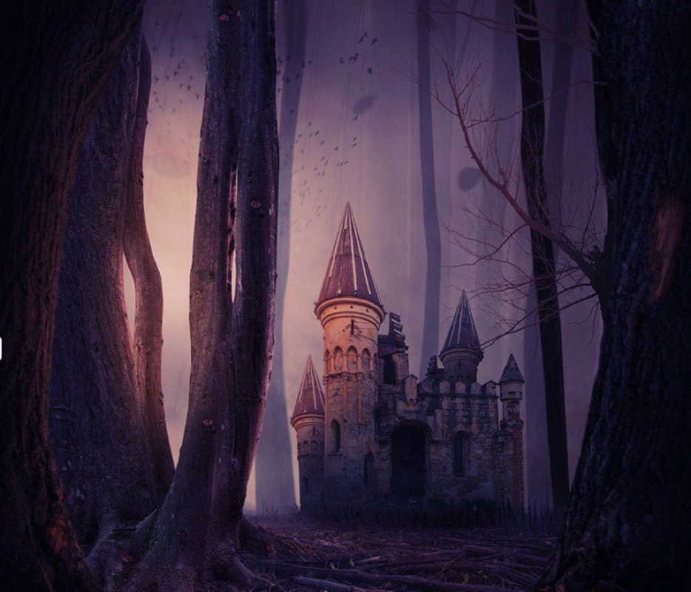
What can you see in this picture?
Write all of the things that you can see in this picture.
Picture by Pobl365

Slide 12
small words
On your whiteboard, write down all of the words that you can think of that mean the word small.

Slide 13
Pick 2 numbers
Pick two numbers between 0 and 20.
Add your numbers together.
Take the smallest number away from the biggest number.
Write your numbers in words.
Finished? Pick two more numbers!

Slide 14
Greater than or less than
Draw your crocodiles to show if these numbers are greater than or less than.
8 10
7 6
14 19
20 9
13 12
12 13

Slide 15
Emotions
Tell your partner about a time when you have felt happy. ☺
Tell your partner about a time when you have felt sad. ☹
Tell your partner about a time when you have felt excited.
Tell your partner about a time when you have felt worried.

Slide 16
Your weekend comic strip
Fold a piece of paper in half and then in half again. You should now have four boxes.
In your boxes, create a comic strip showing your perfect weekend. If you could do anything, what would you do? Where would you go? Who with? What would you eat?
MY AMAZING WEEKEND

